Slide 1

“One Team - One Mission”
Key Four Training
Del-Mar-Va Council
Boy Scouts of America

Slide 2

Stand for Pledge to the Flag

Slide 3
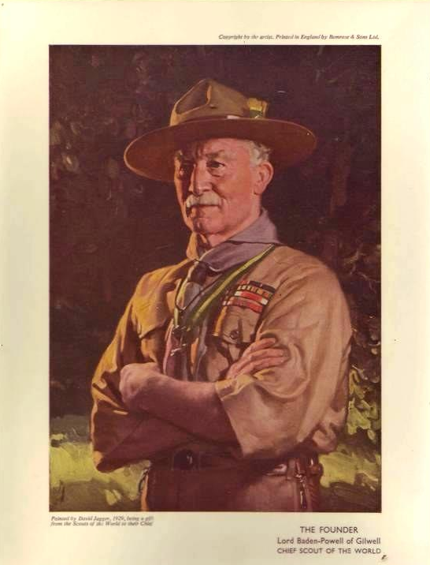
Boy Scouts Founder
Lord Baden-Powell
of
Gilwell
Chief Scout
of
The World

Slide 4
The Key Four
Who are they?
Charter Representative
Institution Head
Committee Chair
Unit Leader (Cubmaster, Scoutmaster, Venturing Advisor)
Notes:
Who are the Key Four?
A Key Team Concept is an integral part of the BSA organizational structure.
This approach brings the focus of different skill sets and different perspectives to bear on program management.

Slide 5
Quality Operations
Volunteer Engagement
Staff Guidance & Support
Notes:
This display shows the Force Multiplier at work.
The diagram shows that input from any wheel can drive the organization.

Slide 6
Staff Support & Guidance
Engaged Volunteer Leadership
Operational Resources
Engaged Charter Partners
Trained & Effective Leaders
Engaged Parents
Planned Program
Camping
Advancement
Satisfied Customers
Scout Retention
Notes:
The foundation of the Key Four concept is the “Engaged Charter Partner”.
This program helps the asset become more involved to program delivery.
It allows parents to become a large part of the Scout’s experience.
It insures that a meaningful program will occur.

Slide 7
Duties and Responsibilities of the Charter Organization
Help select leadership for the unit.
Promote well-planned unit programs: outdoor programs, advancement, and recognition.
Serve as a liaison between the unit and the organization.
Promote the recruiting of new members and units.
Suggest Good Turns to benefit the organization.
Encourage the unit committee to hold meetings.
Cultivate organization leaders and encourage necessary training of existing and new leaders.
Utilize district help and promote the use of district personnel and materials.
Use approved unit finance policies.
Cultivate resources to support the organization.
Represent the organization at the council level
Notes:
The BSA does NOT own scout units. The BSA has selected community based organizations who want to provide service to youth in their community.
This display shows the responsibilities of the chartered organization.
THIS DEFINES THE CHARTERED ORGANIZATION’S RESPONSIBILITIES.

Slide 8
Duties of the Local District and Council
Respect the aims and objectives of the charter organization
Make available, year-round training, service, program and camping opportunities to the unit and organization.
Provide primary general liability insurance to the organization, its members and leaders.
Provide camping facilities, service centers and a full-time staff to support unit operations.
Notes:
This display gives leaders of the Chartered Organization the resources available from the District & Council.

Slide 9
Key Four - Responsibilities
Institution Head
Charter Representative
Unit Committee Chair
  Role of the Unit Committee
Unit Leader

Slide 10
Institution Head
Agrees to meet with representatives of the BSA on an “as needed basis”
Agrees to identify a representative from the institution who will be responsible for liaison with the BSA
Agrees to select and approve Unit Leaders
Agrees that the institution will provide adequate meeting facilities for the unit
Agrees to conduct the Scouting Program according to its own policies and guidelines, as well as those of the BSA
Agrees to include Scouting as part of its overall program for youth and families

Slide 11
Chartered Organization Representative
Serve as liaison between units, your organization, and the council structure.
Encourage unit leaders and committee members to take advantage of training opportunities and to regularly attend district roundtables.
Promote well-planned unit programs
Organize units to serve the youth needs of your organization and its community.
Promote the recruiting of new members

Slide 12
Chartered Organization Rep. – Cont.
See that Scouts and adult volunteers graduate from one program phase to the next phase
Assist with annual charter renewals
Suggest unit “Good Turns” for your organization
Encourage regular unit committee meetings
Encourage the pursuit of Journey To Excellence
Inform organization leaders of council policies
Encourage active outdoor unit programs

Slide 13
Unit Committee Chairman
Organize the committee to see that all functions are delegated, coordinated, and completed.
Maintain a close relationship with the Chartered Organization Representative and the Unit Leader
Present national and local BSA policies to the units.
Prepare committee meeting agendas, preside over and promote attendance at committee meetings and any special meetings.
Ensure unit representation at monthly roundtables.
Secure appropriate individuals for camp leadership.
Plan the charter presentation.

Slide 14
Unit Leader
Be at least 21 years of age and registered as an adult leader of the BSA.
  Be able to communicate well with adults as well as Scouts
  Be able to delegate responsibilities and set a good example through behavior, attitude, and uniform.
  Complete appropriate training including youth protection and leader specific training programs.
  Be able to attend monthly roundtables.
  Be aware and use appropriate BSA literature.
  See that the unit program, leaders, and youth reflect the interest and objectives of the chartered organization and the BSA.
  Work with the unit committee on program ideas, selecting and recruiting adult leaders, and establishing a budget plan.
  Guide and support assistant leaders. See they receive the required training for their positions.

Slide 15
Unit Leader – cont.
Establish and maintain good relationships with other BSA units chartered to the organization.
Maintain good relationships with parents and guardians. Seek their support and include them in activities.
See that responsibilities specified for assistant unit leaders are carried out.
Help the unit committee chair conduct the annual unit program planning conference and the monthly unit leaders meetings.
Take part in the unit charter review meeting and annual charter presentation ceremony.
Conduct meaningful advancement recognition, graduation ceremonies and Courts of Honor.
Encourage high advancement standards for all youth.
Support the policies of the BSA.

Slide 16
Unit Committee
Advise the unit leader on policies relating to Scouting and the chartered organization.
Assist in transportation
Assure that a qualified substitute leader is assigned if unit leader is absent or unable to serve.
Assure that quality adult leadership is recruited and trained (Scoutmaster/Cubmaster) encourage adult leader training.
Carry out the policies and regulations of the BSA.
Coordinate the FOS campaign.
Encourage leaders.

Slide 17
Unit Committee – cont.
Manage unit finances.
Obtain and maintain unit equipment.
Provide adequate meeting facilities.
Recruit and involve unit committee members.
Serve on boards of review.
Solve behavior problems that can’t be resolved within the unit.
Support unit program delivery.
Support youth recruitment.

Slide 18
Council / District Resources
District Committee
Commissioner Staff
Program Committees: Advancement, Training and Camping
On-line Resources
Council Field Staff
Council Support Staff

Slide 19
Customer Satisfaction and Retention
Achieve 75% Youth Retention by 12/31/2019

Slide 20
QUESTIONS?
or
COMMENTS?

